Slide 1

Numerical Investigation on Reduction of Sloshing
induced Pressure using baffles
Bachelor Term Project-II
Under the Guidance of
Professor Swapnadip De Chowdhury
Submitted by
Choudhary Aman Navalkishor
19NA30012
Ocean Engineering and Naval Architecture
IIT Kharagpur

Slide 2
Content :-
Aim of the Numerical Experiment
Introduction to sloshing
Impact due to sloshing
Design Consideration for sloshing
Numerical methods to investigate impact pressure
SPH(Smooth particle Hydrodynamics)
Case setup
Observations without baffles
Observations with baffles
Conclusion
Future work

Slide 3
Aim of the Project:-
The main idea of this project is to numerically find the abrupt pressure on inner side of the wall with respect to time caused by violent sloshing
Cases considered :
one of simple sloshing and other with an obstacle(baffle)
comparison with the experimental data for verification

Slide 4
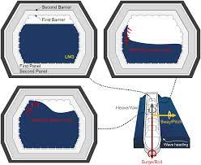
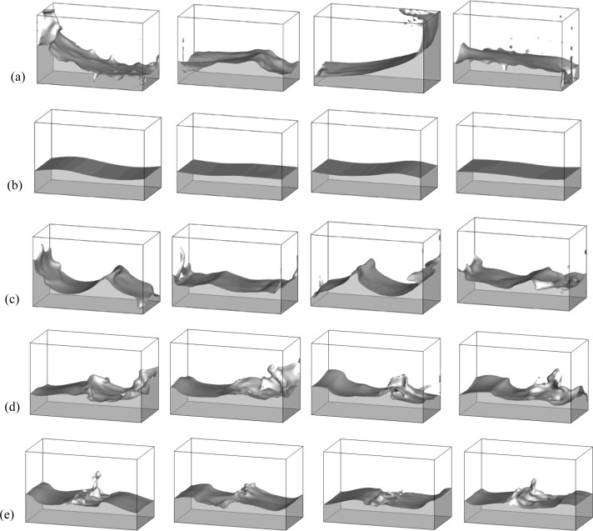
Introduction: -
Sloshing: dynamic behaviour of the free surface due to external excitation.
High impact load in shallow depth.
Means of reducing sloshing pressure: baffle (solid/ elastic/ porous).

Slide 5
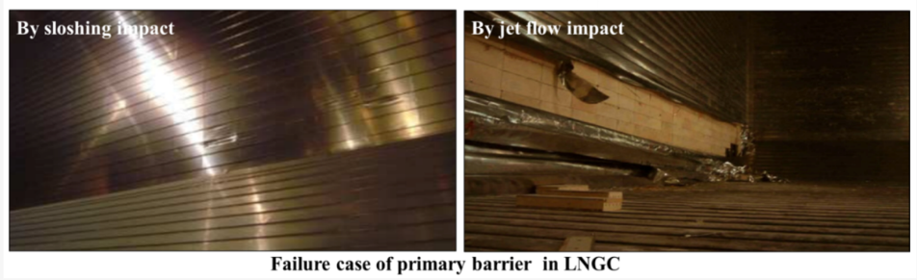
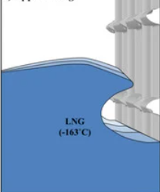
Impact due to sloshing
In tanker ships, sloshing can be a significant hazard due to the motion of the ship in sea waves. When partially filled tanks experience sloshing, it can create heavy impact forces on the tank walls and structure, which can cause damage .

Slide 6
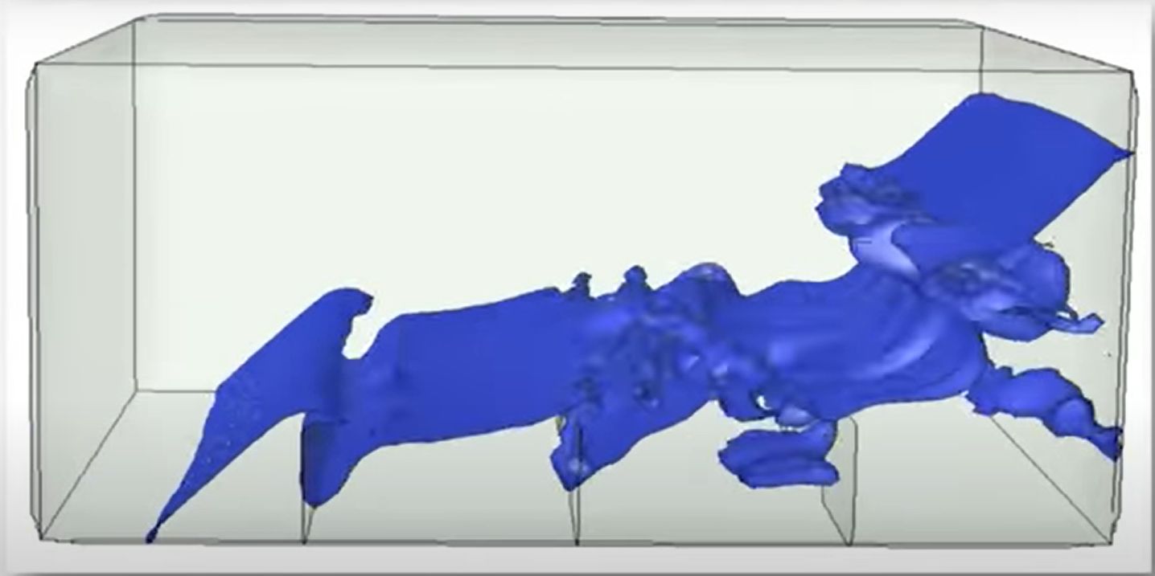
Design Considerations for Reducing Sloshing
One method to reduce sloshing is to design the container with specific features in mind. For example, baffles can be added inside the container to disrupt the flow of liquid and prevent large waves from forming.
Another design consideration is to use materials that are less susceptible to sloshing : composite materials.

Slide 7
Numerical Methods to Investigate Impact Pressure
Numerical methods are commonly used to investigate impact pressure in various applications, such as in fluid dynamics, structural engineering, and material science.Several types of meshfree methods have been implemented to analyze the free-surface flow characteristics and sloshing motion in liquid containers subjected to external excitations. Some common numerical methods used for this purpose are:
Traditional methods: FEM[1], FDM[2], BEM[3], FVM[4].
Meshfree particle methods: SPH, MPS, MLPG, PFEM.
[1]: P. Nithiarasu , THE FINITE ELEMENT METHOD FOR HEAT AND FLUID FLOW , Annals of the Assembly for International Heat Transfer Conference , 2006
[2]: Nobumasa Takemitsu , Finite difference method to solve incompressible fluid flow , Journal of Computational Physics , 1984
[3]: D. Lesnic, L. Elliott, D.B. Ingham , Boundary element methods for determining the fluid velocity in potential flow ,
Engineering Analysis with Boundary Elements , 1992
[4]: Demirdžić, M. Perić , Finite volume method for prediction of fluid flow in arbitrarily shaped domains with moving boundaries , International Journal for Numerical Methods in Fluids , 1990

Slide 8
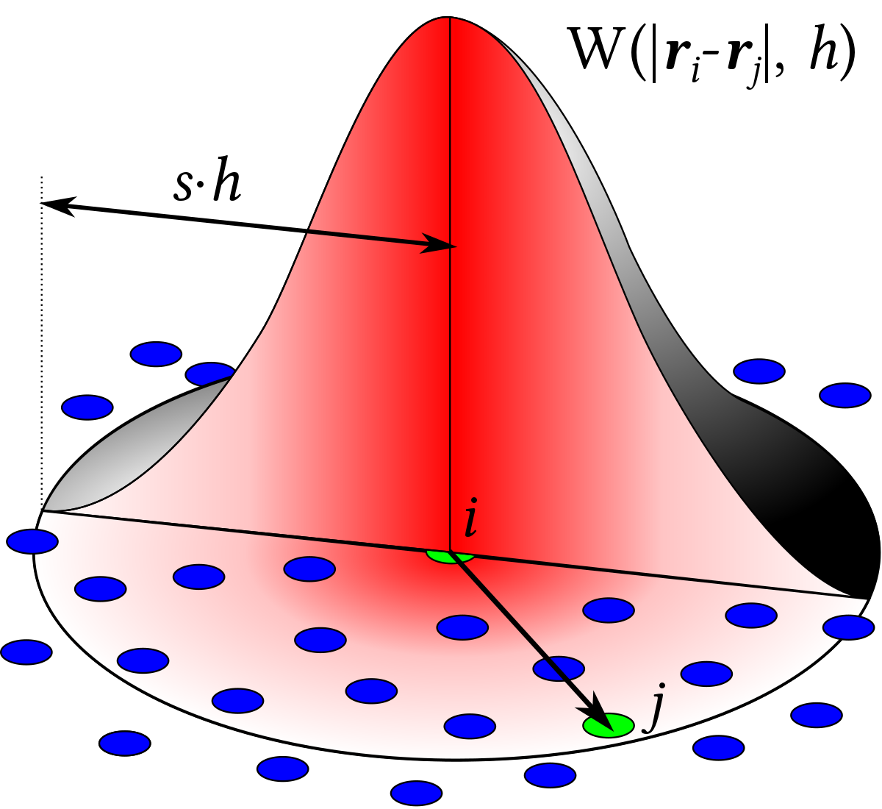
Smoothed Particle Hydrodynamics(SPH) in Sloshing
Smoothed Particle Hydrodynamics (SPH) : meshfree Lagrangian method for easy handling of violent fluid motions.
Fluid and solid domain using discrete lumped mass.
Dummy particles to provide full support domain in the solid region.
No need for mesh: interacting particles using kernel interpolation.
Key challenge: estimating pressure gradient for discretized Euler equation.

Slide 9
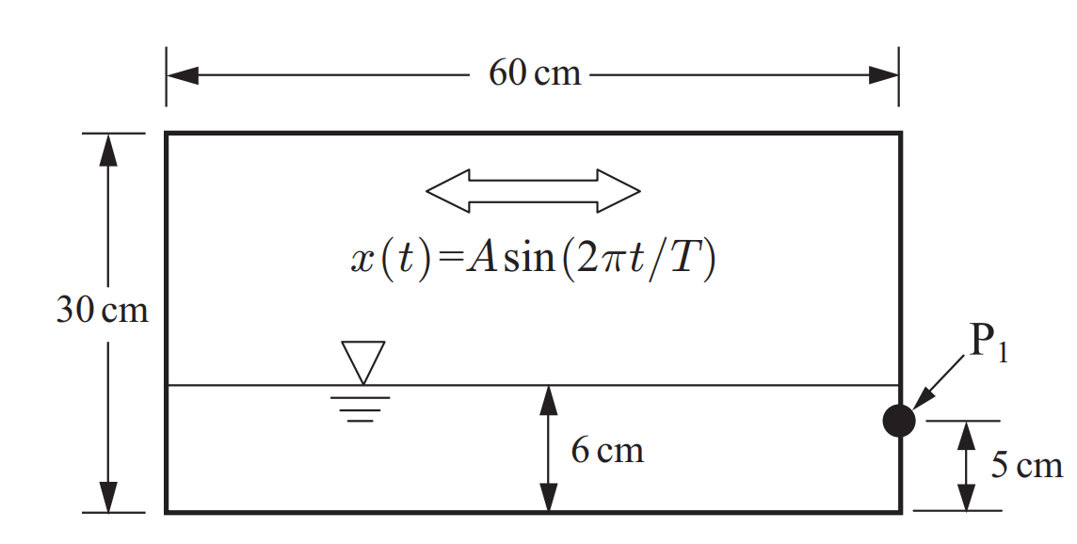
Case Set-up
A = 0.06 m ; Width of tank = 0.6 m ; Height of tank= 0.3m
Height at which pressure is measured= 0.05 m
Height upto water is filled = 0.06 m
For simple sloshing case we are taking no. of particles in x direction for three different cases as 100, 130 and 200 to generate the pressure plot at the left corner.
For the baffle cases we have taken three different height of baffle as 0.048m , 0.024 m and 0.012 m to generate the pressure and compare it with the experimental data.

Slide 10
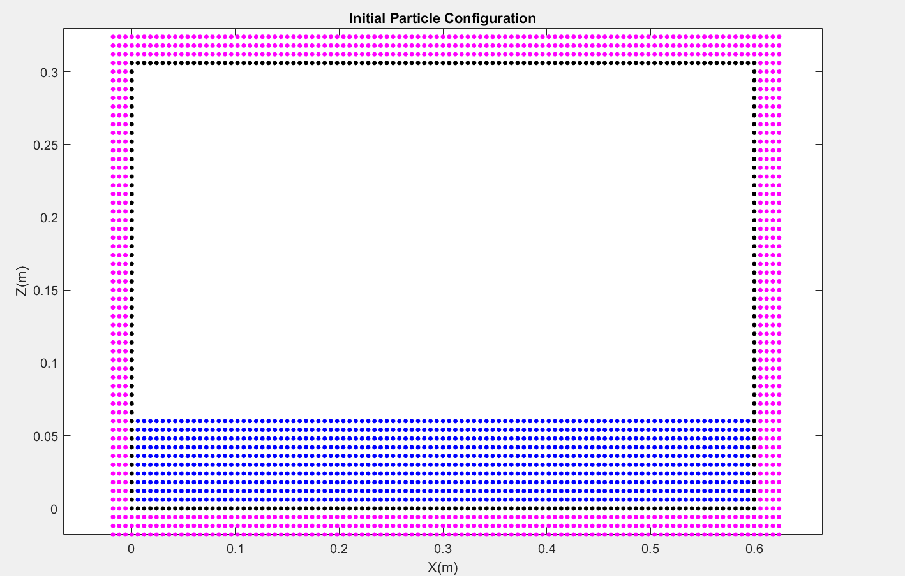
Observations for 1st case:-
Number of particle in x direction :- 100
Number of particle in z direction :- 10

Slide 11
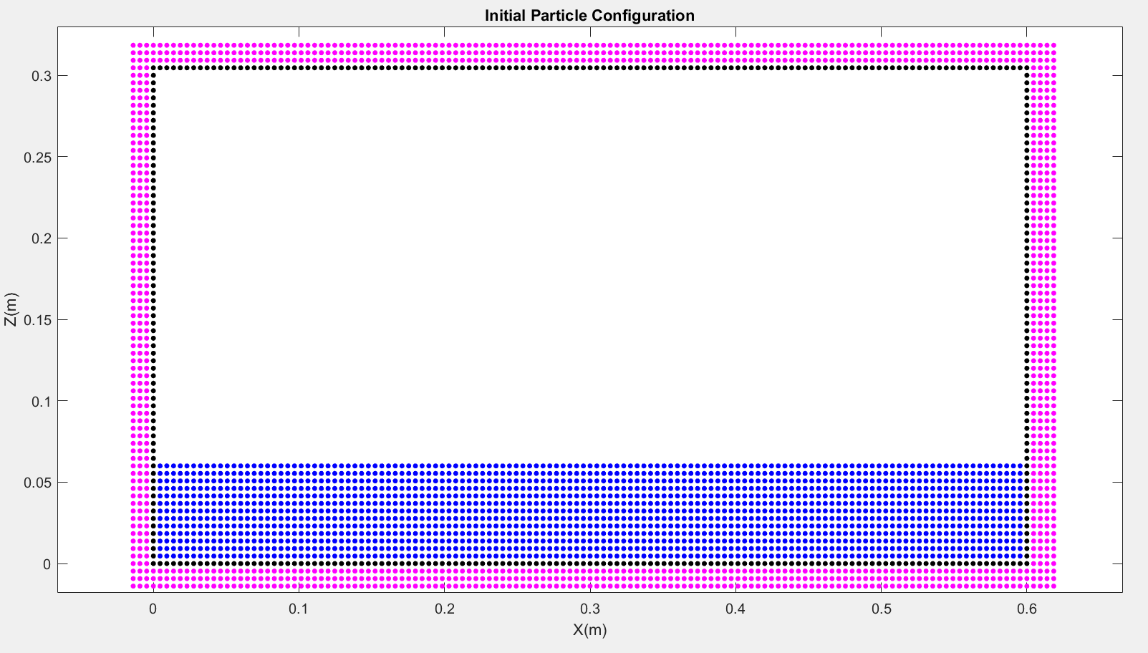
Number of particle unit in x direction :- 130
Number of particle unit in z direction :- 13

Slide 12
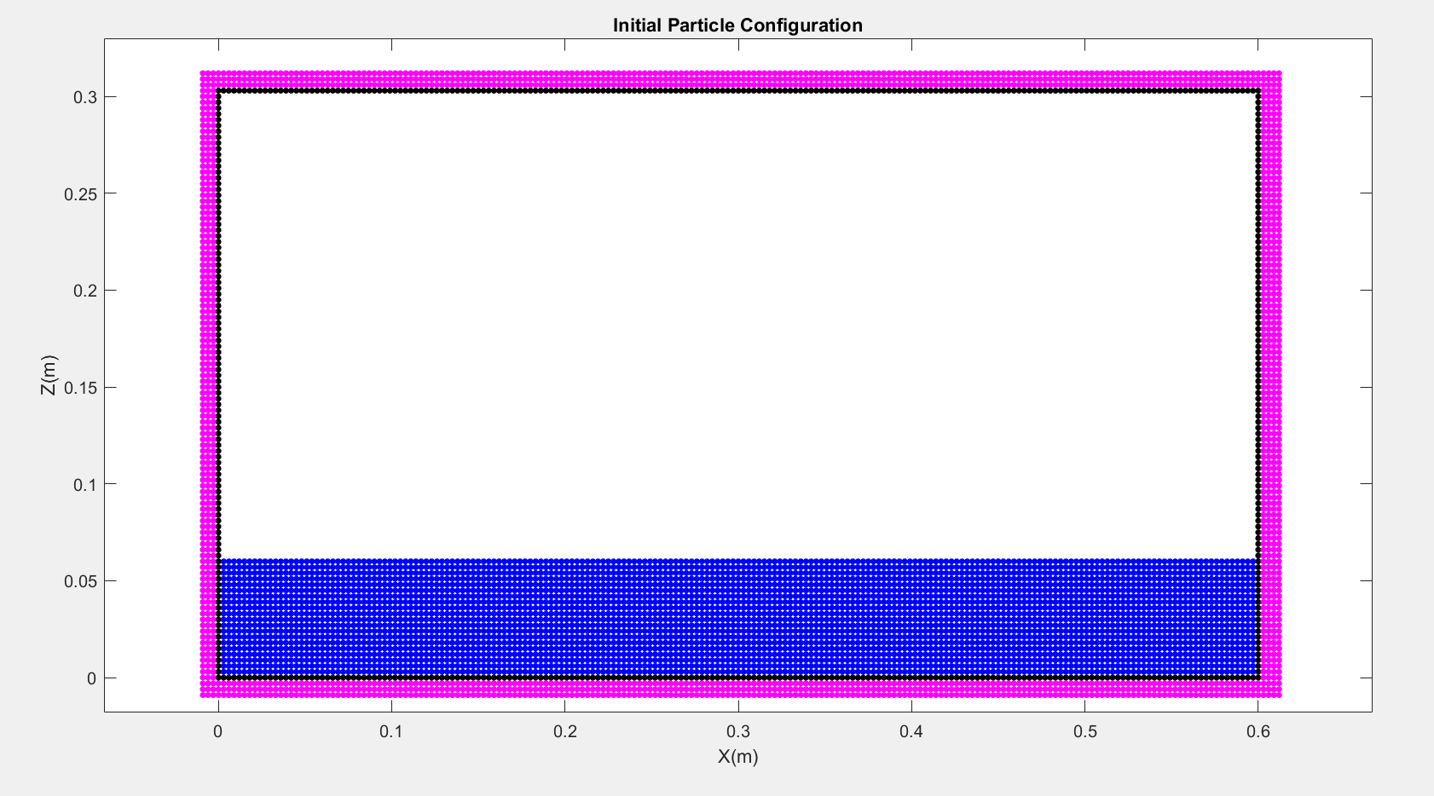
Number of particle in x direction :- 200
Number of particle in z direction :- 20

Slide 13
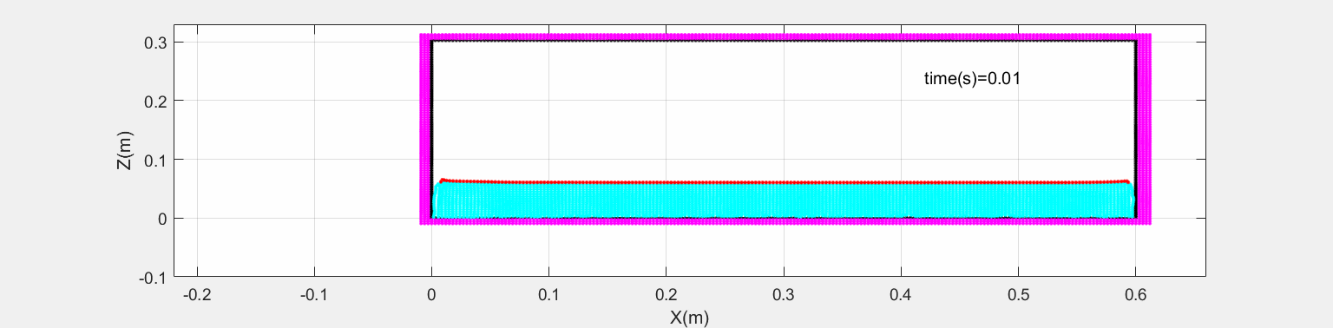
Sloshing motion inside tank

Slide 14
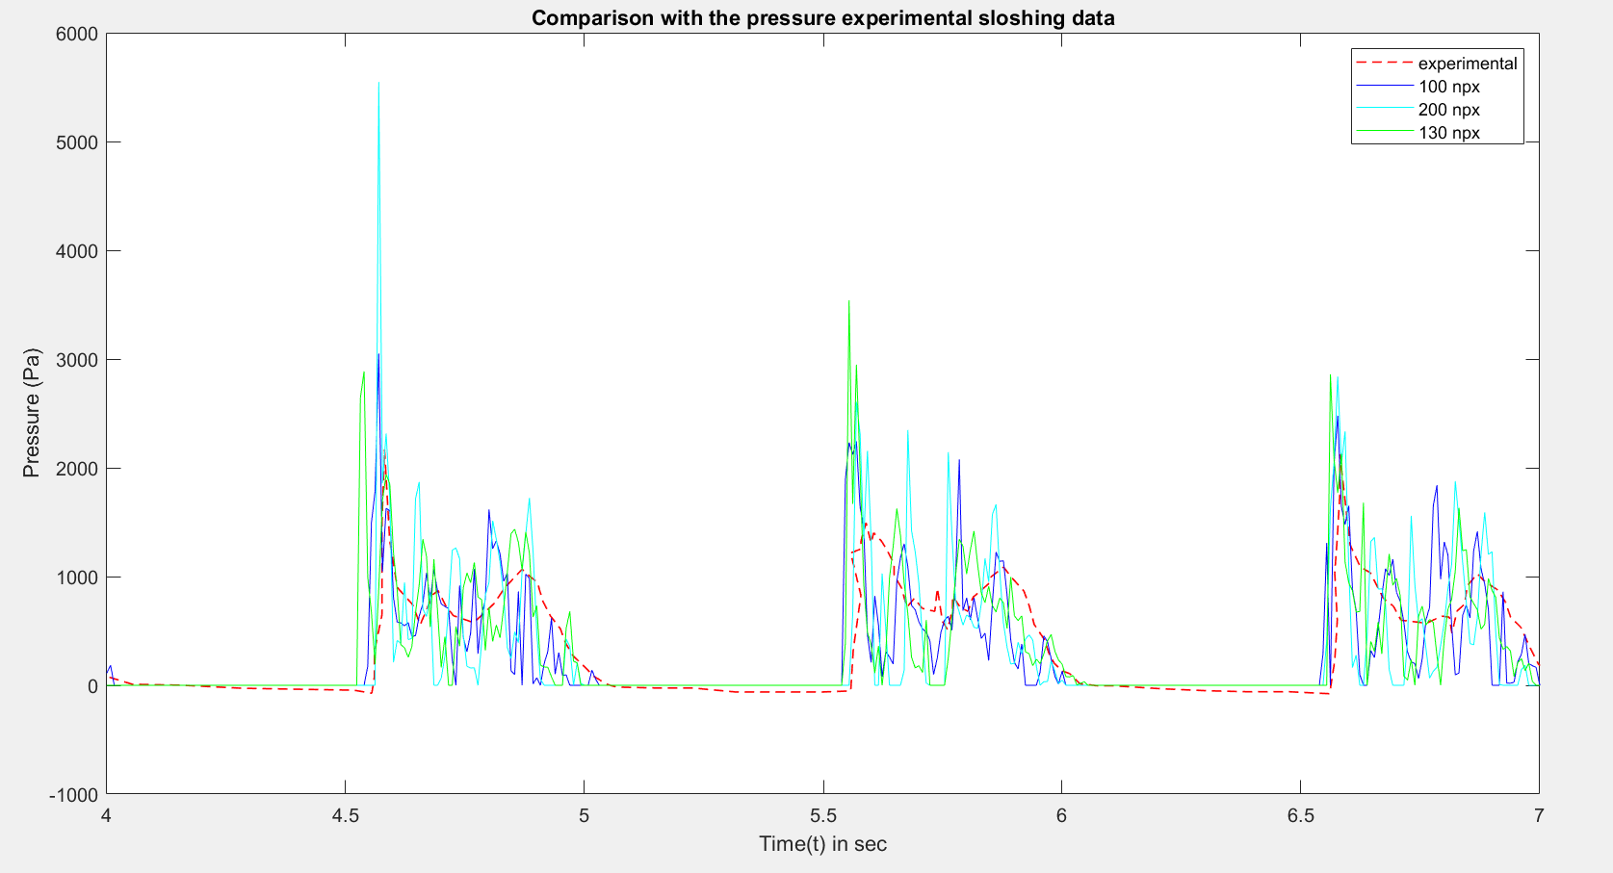
Pressure plot comparison different fluid visualisations :- 100, 130 and 200 (number of particles) with experimental data

Slide 15
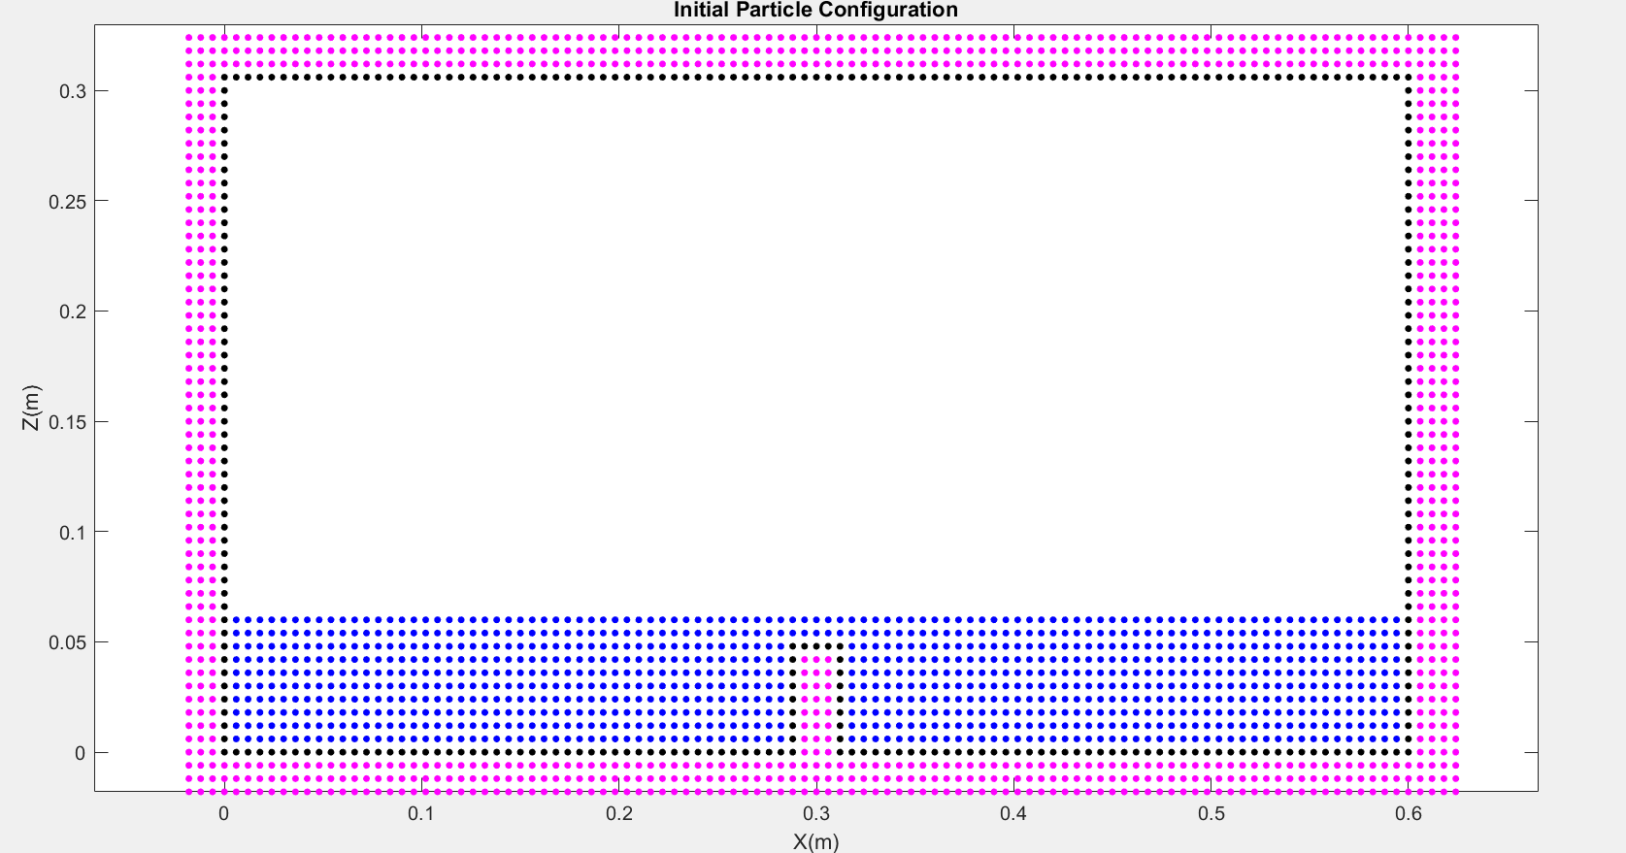
Observations for 2nd case :-
Height of baffle= 0.048 m
Initial particle configuration

Slide 16
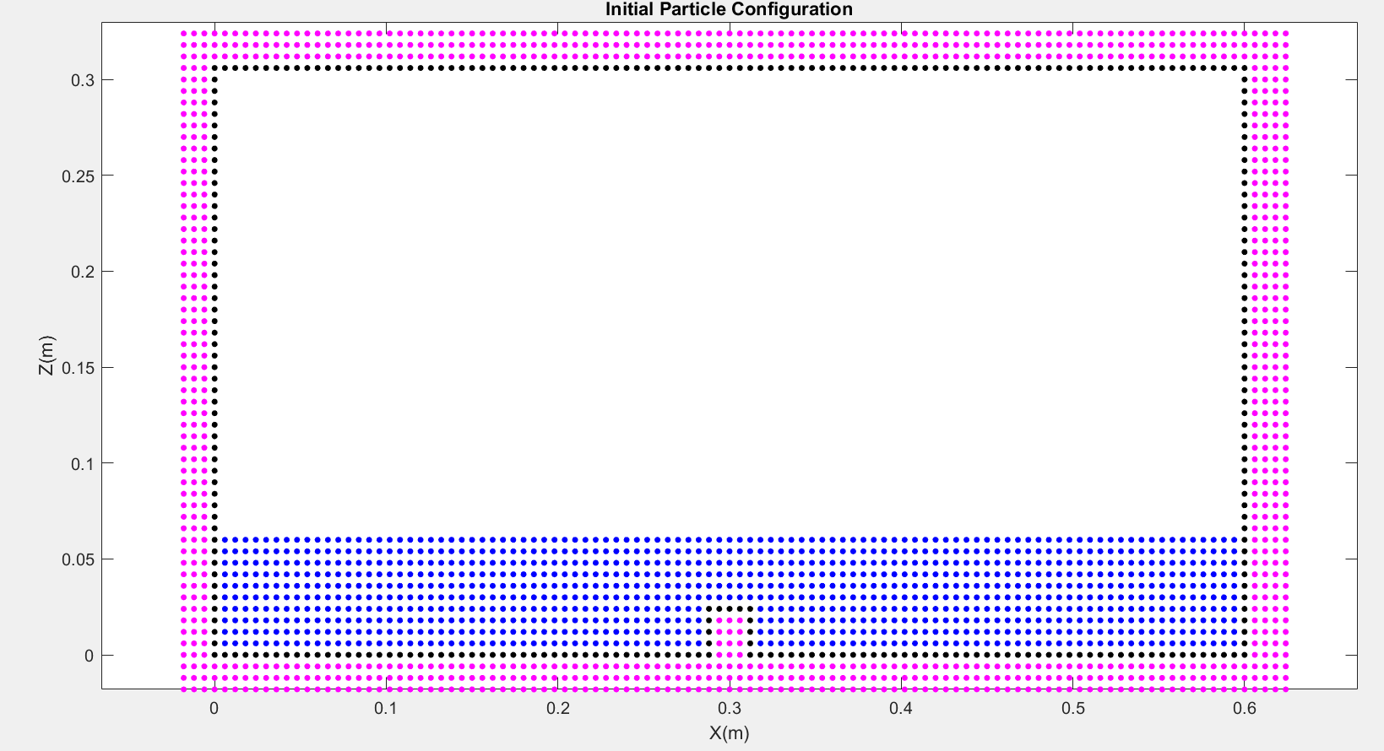
Height of baffle= 0.024 m
Intial particle configuration

Slide 17
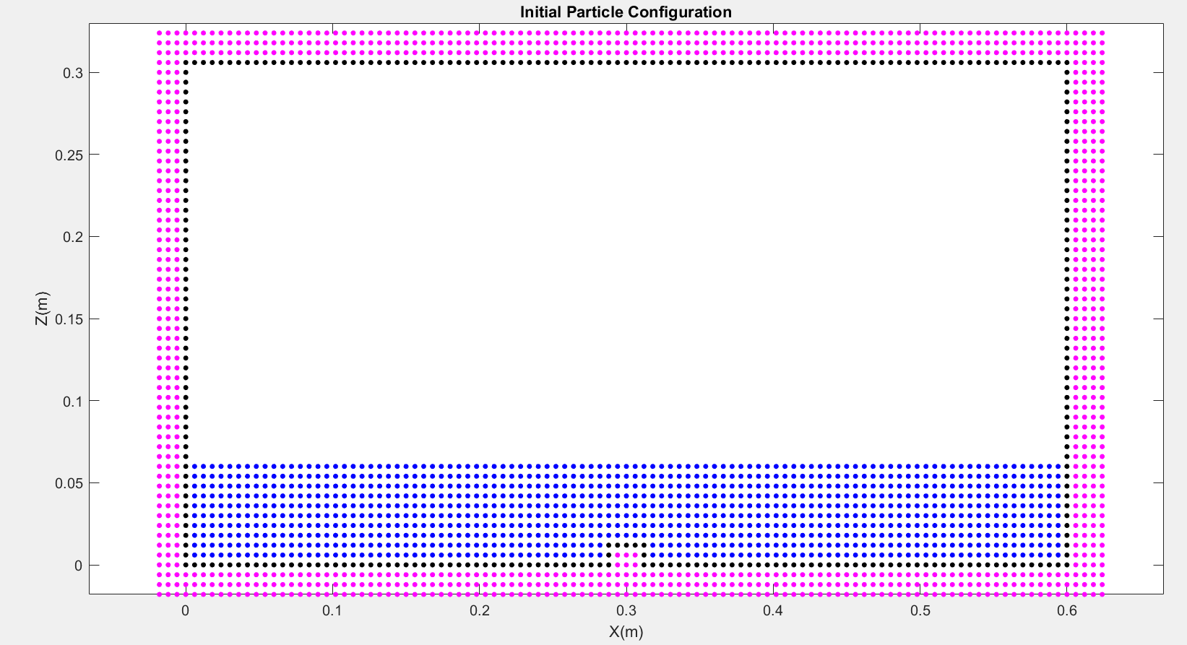
Height of baffle= 0.012 m
Intial particle configuration

Slide 18
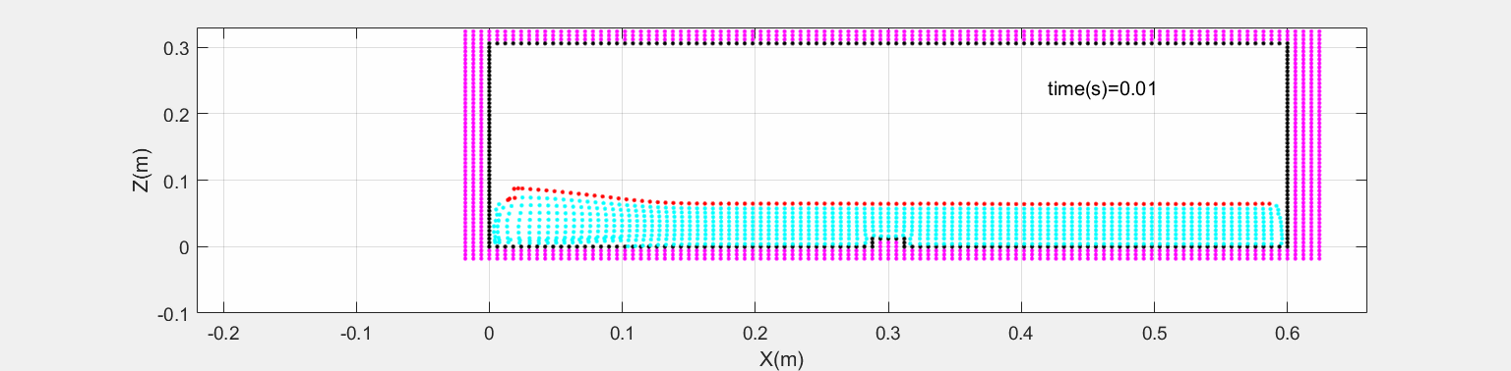
Sloshing motion with baffle
Height of baffle = 0.012 m

Slide 19

Sloshing motion with baffle
Height of baffle = 0.024 m

Slide 20

Sloshing motion with baffle
Height of baffle = 0.048 m

Slide 21
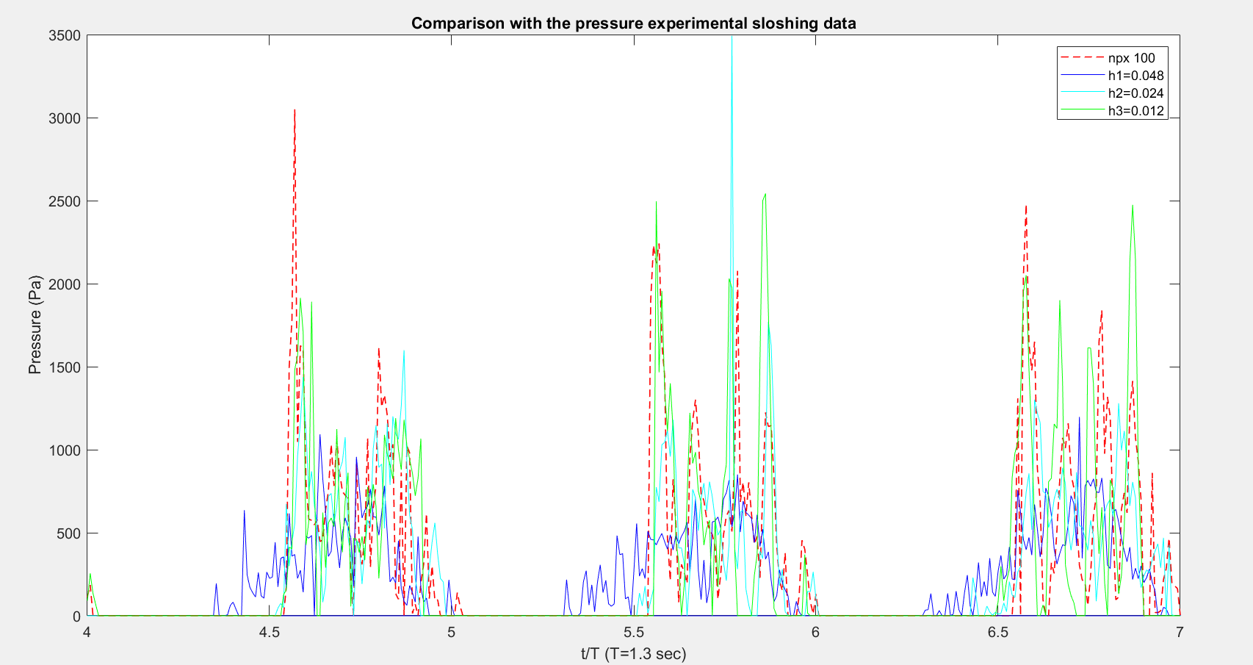
Pressure plot comparison of height:- 0.048m, 0.024 m and 0.012 m with100 npx(no baffle)

Slide 22
Conclusions:
The sloshing impact reduces due to baffles
With baffles the violent fluid motion has been drastically reduced
Roof impact has been avoided with the baffle of height 0.048 m.

Slide 23
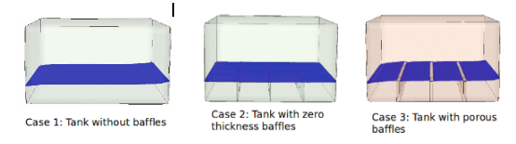
Future Work:-
Multiple baffles at different locations.
Porous (Gap baffles ).

Slide 24


